Slide 1
Subsea Services Inc.
Internal Project
Web site
07 Sep 2016

Slide 2
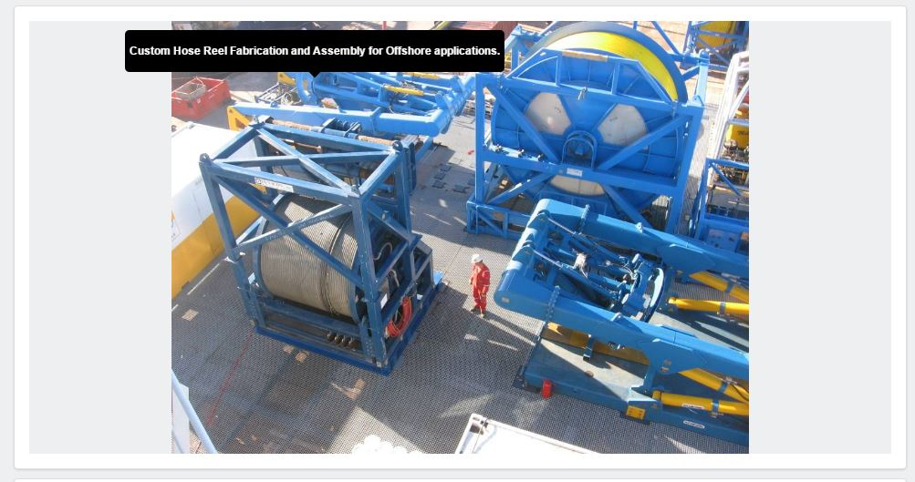

Comment-1
Please add the image order/legend similar to one highlighted on the right side screen shot.

Slide 3
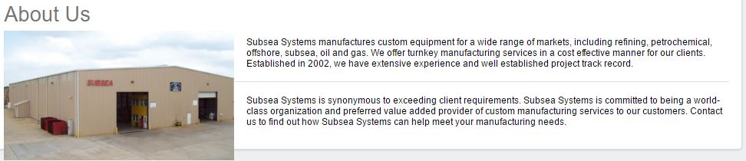
Comment-2
The picture should be in “About US” page. This picture is not worthy of home page.
Also, there is not title for this introduction content.
At 100% browser view size, the page content is crossing the browser borders. Any ideas to improve the look?

Slide 4
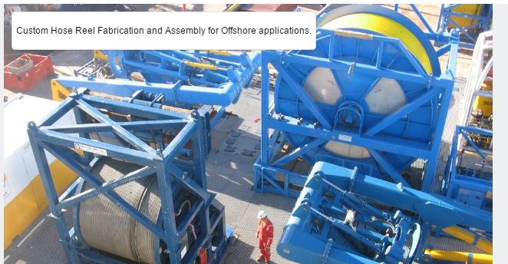

Comment-3
Keep the text as shown right side screen shot.
I suggest we should be able to position the Caption at 4 locations
left top or Left bottom or Right top/Right bottom. I want to use this text to hide sore objects (like bottle sprayer in a picture, do not block important visual message etc.)

Slide 5
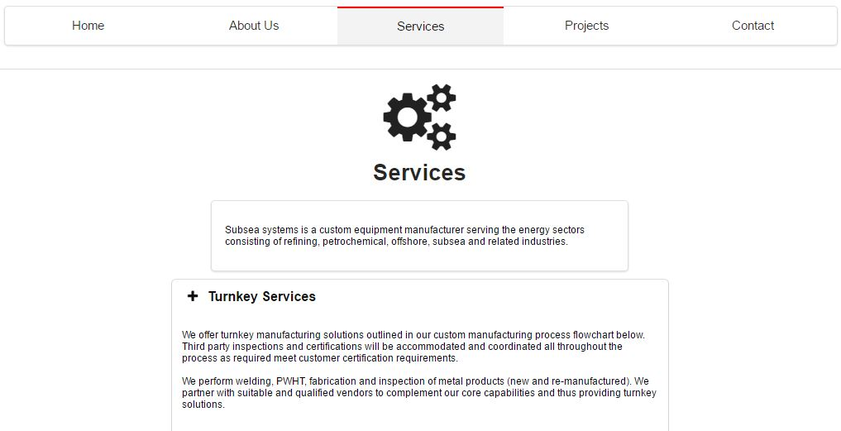
Comment-4
Change the background colour because it seams like both are coincide with each other.
Again, At 100% browser view size, the page content look and extent should be consistent among all pages.
Key is to have a consistent pages across the website. This can be achieved by using a single/consistent .CSS design across all pages.

Slide 6
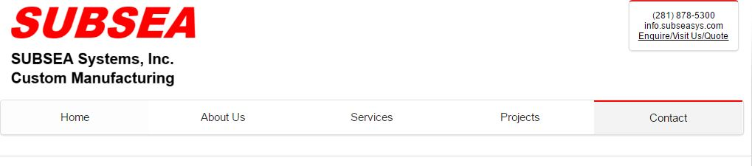
Comment-5
Excess white space is a waste. Use every pixel to our advantage. can we squeeze the menu between logo & content? In services and contact page the space is more when compared to home and about us page.

Slide 7
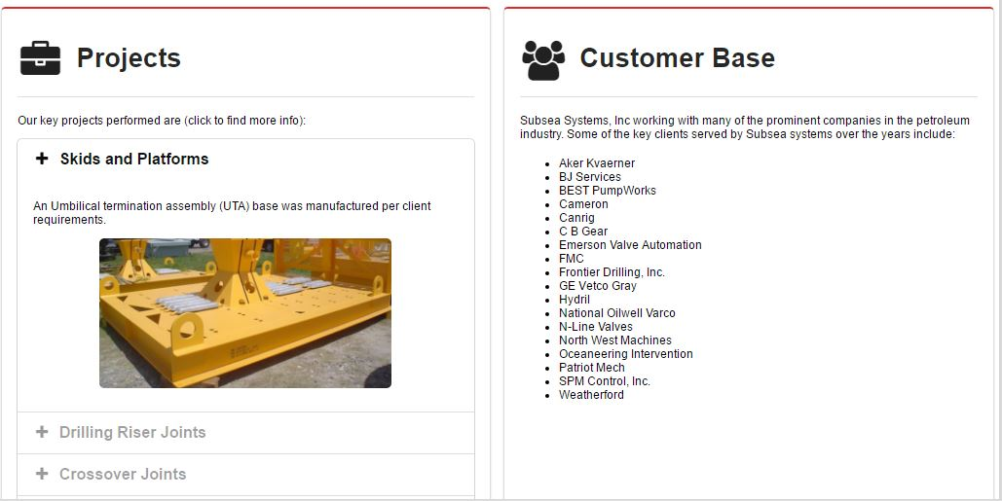
Comment-7
Please separate the projects and customer base.
Again, At 100% browser view size, the page content look and extent should be consistent among all pages.
Make the 2 topics flow from top to bottom. Customer base can be at the top of the page followed by projects.

Slide 8

Comment-8
Present only keep the linkedin page
For now, keep Only LINKEDIN page.
We may have to hide it if required until they have a LinkedIN page.

Slide 9
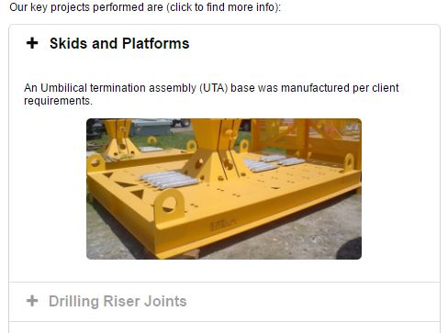
Comment-6
In projects page, while scrolling the key projects it’s showing the Plus symbol while scrolling keep negative symbol. Please highlight the image while keeping the mouse on image.

Slide 10
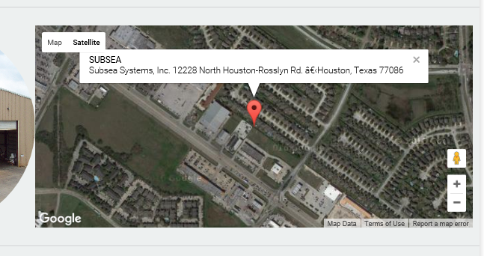
Comment-9
Do not make the map below active as soon as we hover the mouse. It does not scroll and starts zooming into map.
Make the map active and interactive only after we click on it.

Slide 11
Comment 10
Key is to have a consistent pages across the website. This can be achieved by using a single .CSS design across all pages.

Slide 12
Certifications Images
We converted the certification PDFs into images. See link below:
0119 Programming\PDF Images
Please use them for the website.

Slide 13
THANK YOU
For the opportunity to serve!

Slide 14
Document Revision History
01 | PRE-0001-01 Web report preview comments | 1 Sept 2016 |  | GSY | VA | ?
Rev | Description | Date |  | Author | Checked | Approved
Document No: |  |  | Client Ref:
PRE-0001-01 Web report preview comments |  |  | n/a

